Slide 1

Strategy Of Campus WLAN Network Security Based on University Management
Sri Lanka Institute of Information Technology
Department of Information Technology
Nethun Kawitha Madanayake
IT18107692

Slide 2
Table of Contents
Introduction
The campus network security threats
Internal security threats faced by the Campus Network
External security threats faced by the Campus Network
Campus Network defects and physical security threats
Strengthen safety education to strengthen the management practices
The proper use of the password the encryption means
The use of anti-virus techniques adhere to the preventive detection
Focus on physical techniques to fix vulnerabilities
Established security standard ISO / IEC_JTCI11
Proposed Solution For Campus Network Information Security Problem
Conclusions

Slide 3
Introduction
The campus network is a collection of teaching, research, administrative, educational administration and general management functions into one integrated network
IT has many function , They are Internet Services , Remote Education , Video Conferencing , Exams , Student Management , Teachers Management , Student services many more things
With the rapid development and popularization of the campus network, the security issues become increasingly prominent

Slide 4
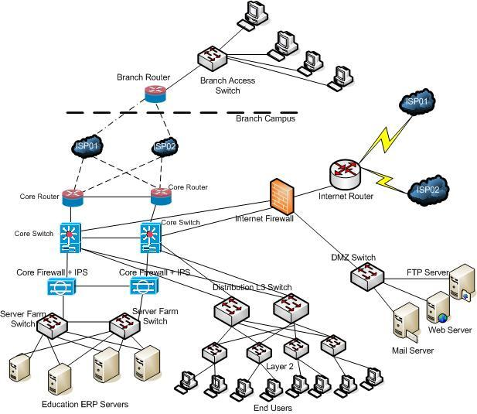
The campus network security threats
Analysis of the characteristics and common threats to the campus network security management , the security issues are increasingly highlight computer viruses, hacker attacks, data tampering and loss of network security risks
Network security commonly used techniques such as firewalls, VLAN, and so on, made a series of security policy for the campus network characteristics
Campus network security threats are mainly produced in internal and external

Slide 5
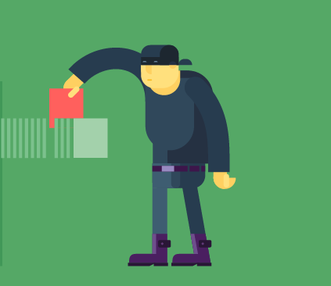
Internal security threats faced by the Campus Network
Unauthorized access to internal users in the campus network is one of the main campus network security
Internal users to malicious attacks
Physical theft of company devices
Use of unauthorized devices
Notes:
Many more social engineering
Downloading malicious internet content
. Information leakage
Illegal activities

Slide 6
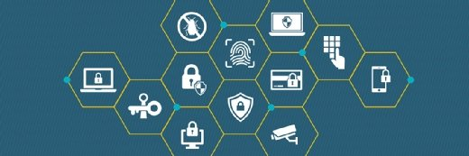
External security threats faced by the Campus Network
Computer viruses are the main reason for the campus network is facing external security threat.
External hackers hack programs, system vulnerabilities, remote control computer, and even direct damage to computer systems.
Password attack
Phishing and spear phishing attacks

Slide 7
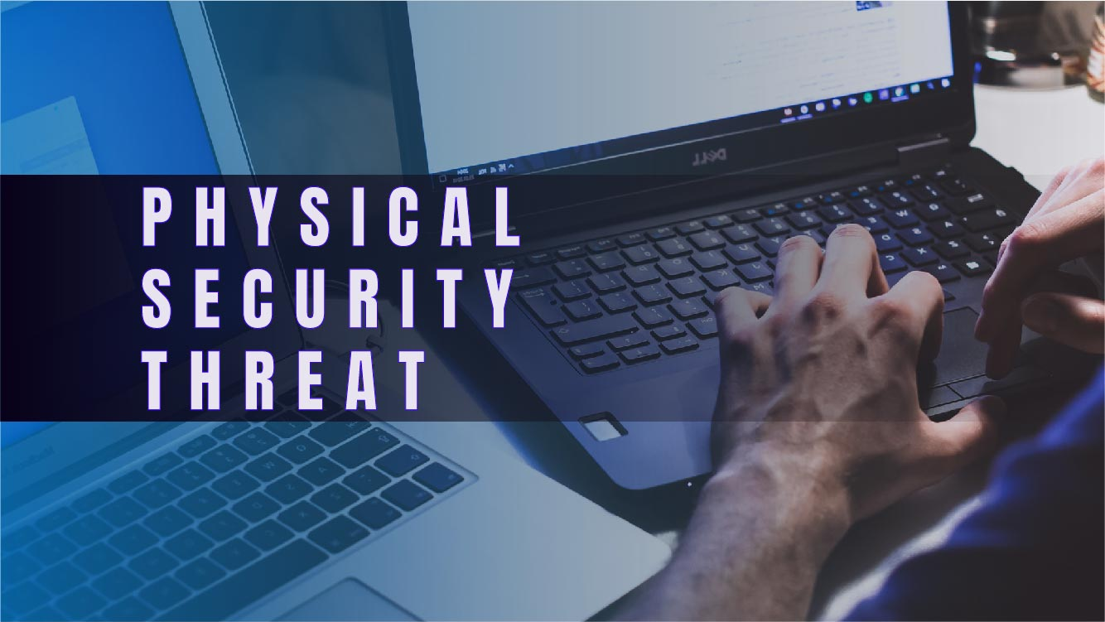
Campus Network defects and physical security threats
Addition by the security threats from inside and outside the system, the campus network, there are other security risks.
Password-protect
Use anti-malware and anti-virus protection
Deliberately monitor and configure application privacy settings
Constantly back up your device data
Allow remote location and device-clearing

Slide 8

Strengthen safety education to strengthen the management practices
The proper use of the password the encryption means
The use of anti-virus techniques adhere to the preventive detection
focus on physical techniques to fix vulnerabilities

Slide 9
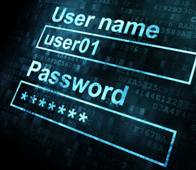
The proper use of the password the encryption means
Set a password. To frequent changes to the system administrator account and set arbitrary
There is a sufficient length of the password
The password you set should be a complex password with letters, numbers, special characters
Build an "Administrator" trap accounts, does not confer any privileges, plus a super- complex password.
nothing.
Use the same password does not know that such has left a security risk. Because attacks are generally cracked a user's password,
Users can reload the encryption and decryption algorithm to construct your own encryption and decryption module. In addition, you can encrypt files and folders "feature, to prevent others from using the computer peek.

Slide 10
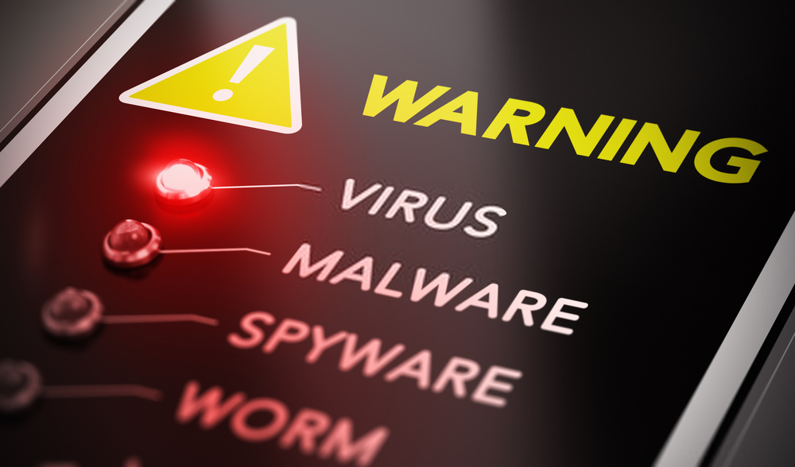
The use of anti-virus techniques adhere to the preventive detection
Protection from viruses and their transmission
Block spam and ads
Defense against hackers and data thieves
Ensures protection from removable devices
Protects your data and files
Firewall protection from spyware and phishing attacks
Limit the access of websites to enhance web protection
Protects System password
Cost-effective

Slide 11
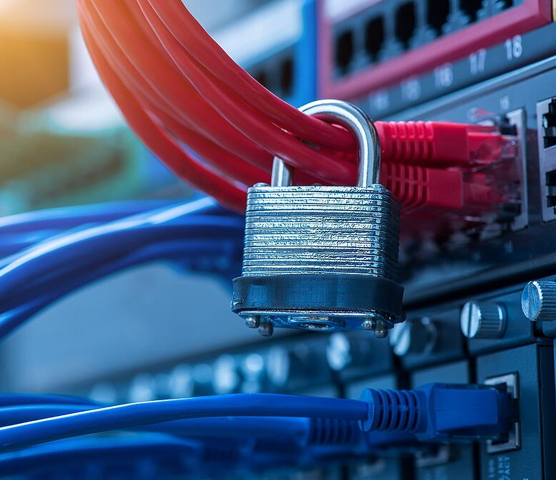
Focus on physical techniques to fix vulnerabilities
Focus on physical security of servers, switches, routers and other hardware in the entities and communication links in the network system protection from natural disasters, man-made destruction and attacks, to ensure that the network computer system has a good electromagnetic compatibility environment; to establish a complete management system to prevent illegal entry into the computer control room and all kinds of theft, sabotage occurred.
Using firewall technology. The best means of defense external threats
Restrict access to specific database application based on user login

Slide 12

Established security standard ISO / IEC_JTCI11
The introduction of ISO/IEC JTC1 standards paved the way for the standardization of information security semantic concepts
the right understanding and identification of those ideas are the most information system `s security semantic concepts
the right understanding and identification of those ideas are most important factors to consider when conducting a good evaluation of an information system `s security efficacy
as well as when identifying and characterizing a security event and estimating its consequences. The suggested conceptual framework aims to assist the organization in determining what should be safeguarded (assets) and what weaknesses (Vulnerabilities) should be safeguarded (vulnerabilities) in their everyday activities
Finally, assess the efficiency and effectiveness of the policies and controls in place to see if they are being applied appropriately or if they need to be tweaked depicts the suggested conceptual framework, which includes three nuclear concepts: assault, threat, and assets

Slide 13

Proposed Solution For Campus Network Information Security Problem
we must first assess security risks and then develop a coordinated action plan based on those findings
We should use more modern technology in our networks, such as firewalls, virtual Local Area Networks (VLANs), encryption, and Virtual Private Networks (VPNs).
Using PKI technology, centralized configuration, monitoring, and administration may be achieved
Finally, we should improve the formulation of network security systems and standards

Slide 14
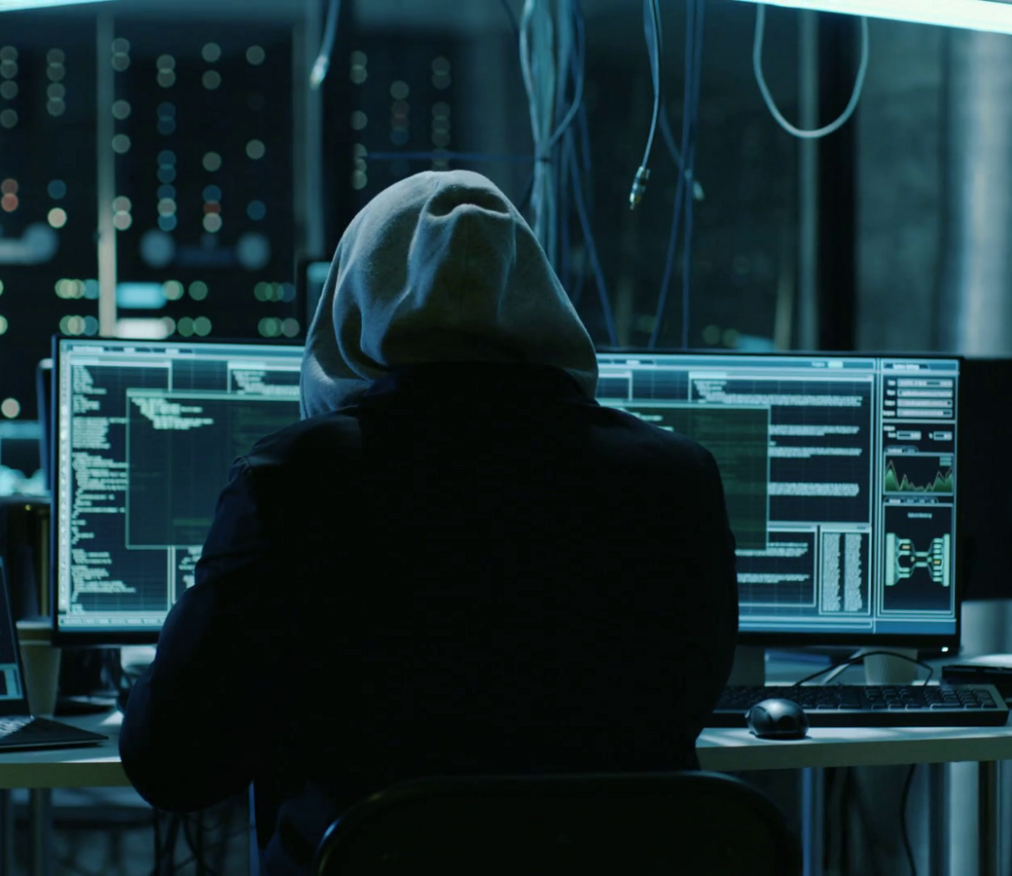
Conclusions
Campus Network Security is a systems engineering problem that requires careful consideration of the systems `s security needs targeted internal education and management, cryptography, virus prevention, detection, system bug fixes, firewall technology , physical security awareness , and security technology advances , the tools and procedures for maintaining campus network will also play a more important role in schools .

Slide 15

Thank You

